Slide 1





BUILD ALEXA ‘SKILLS’
MONDAY 28TH OCTOBER 2019 @PARK CAMPUS | WATERWORTH BUILDING (WW001 &WW002)
9am until 3pm
Amazon will be running an Alexa Skills building development event
for current Level 4,5 and 6 Creative and Technical Computing students*
Sign up/register via Eventbrite: search “Hackazon”
*TEAMS OF 4 REQUIRED

Slide 2

CT4005: Games Production
Lecture 04 – Meaningful Play
John Moss, Dr Will Sayers, and Richard Cook, University of Gloucestershire

Slide 3
In this session
Meaningful Play
Narrative
“The Hero’s Journey!”
Referencing and Academic Writing

Slide 4
Meaningful play
“In play there is something “at play” which transcends the immediate needs of life and imparts meaning to the action. All play means something.” – Gillin and Huizinga (1951)
There are various interpretations of this quote – ranging from the reasonable to the ridiculous
But in my personal opinion, the intent of the author is fairly clear
I believe he is saying, there is more to play than mindless activity. When playing, we play with intent and with an understanding of the meaning of our play, which is shaped by us as players and not created (although it can be helped or hindered) by the rules of the game

Slide 5
Meaningful play
The goal of successful games design is the creation of meaningful play
If an experience is meaningful, the player will continue to experience it, will not get bored of experiencing it, and will want to experience it again in the future

Slide 6

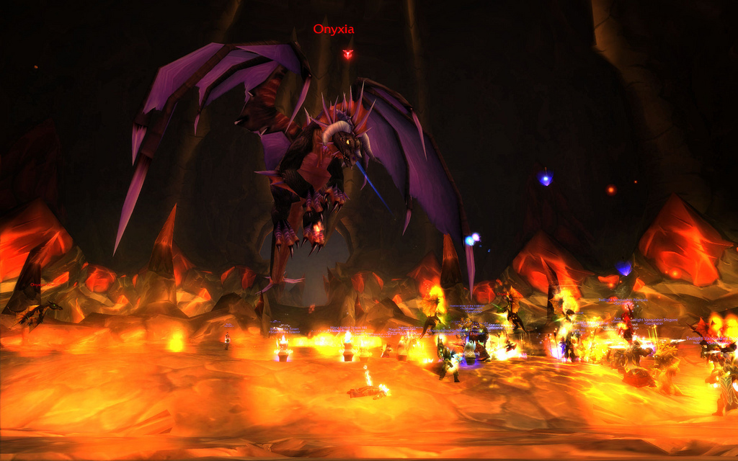
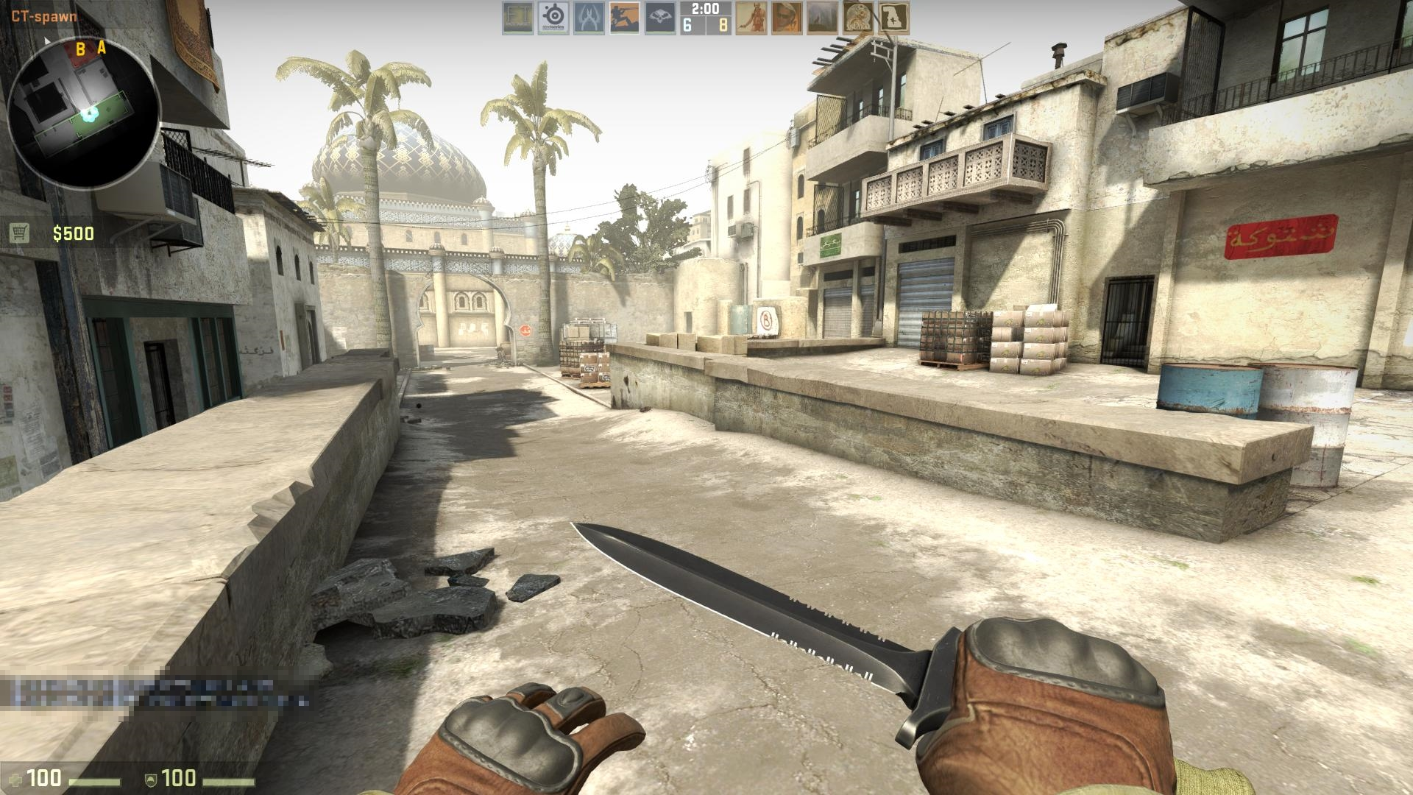
Examples
Some good examples of meaningful play:
Intellectual duelling in chess
Playing as a member of a World of Warcraft raiding team
Playing as a member of a CS:GO team in a tournament

Slide 7
What do these types of play have in common?
They all have extra meaning ascribed by the players to the activity of playing
In Chess, intellectual superiority over ones foe
In WoW, the perfectly executed teamwork, along with individual performance, along with many hours worth of collecting gear, which enables the defeat of an enemy which otherwise could not be. You also potentially gain more gear, towards the next defeat of an enemy
In CS:GO, the defeat of other teams, equally as keen to win as your team is, by virtue of your skill, speed, tactics (and sometimes luck)
In each of these examples, the rules of the game by themselves do not necessarily result in meaningful play
It is the combination of the rules of the game, with the player ascribing further meaning, which gives meaningful play

Slide 8
Meaningful Play
Meaningful play therefore is an emergent property of player interaction with game systems
Good game systems will cause players to experience meaningful play – so how do we aim for this outcome?
For meaningful play to occur, it is important that there is a clear relationship between actions and outcomes
It is also important that the outcomes are integrated into the context of the larger game
If outcomes are integrated into the context of the game, this helps create meaning, those outcomes are created by the players actions in a well designed game – so we’re leading the player towards creating meaning, and therefore towards meaningful play

Slide 9
Actions and outcomes
In chess, when we make an action – move a piece – we experience an outcome immediately – the game state is changed, making us more or less likely to win
This outcome is intimately linked into the context of the game – the aim of the game is to capture the opponents king and every movement made makes this more or less likely
WoW is similar, every action you make affects the likelihood of your teams success at downing the boss
If you don’t down the boss, you won’t get any extra items to help you down further bosses and usually you can’t even attempt further bosses.
In CS:GO, every action made or taken can get you killed or take down an opponent
The more opponents you take down, the more likely you are to win the match, balanced against your opponents being in the same situation

Slide 10
Actions and outcomes
A simple way to think of actions and outcomes, and integrate them into your game designs, is as follows:
Actions MUST have discernible outcomes. If the player performs an action they must know at some point whether it was a good or a bad action to perform.
The outcome from that action MUST contextualise within the rest of the game – it must affect the rest of the game in some way for the player.
The type of game may affect how soon the player knows whether an action is good or bad. In an action packed space fighter game, actions should have immediate outcomes. In a story-driven RPG it may make sense to only reveal the full outcome of a players action further on in the game.

Slide 11
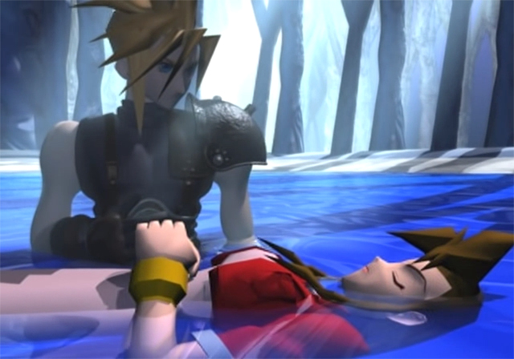
Narrative
One often used driving force in games is narrative
This can be used to give outcomes, where the next part of the story is revealed in response to a players successful actions
And to contextualise those outcomes into the larger game – the next section of the story forms part of the whole, which forms the motivation for the player within the game
It is important to note that having an idea for a story is NOT the same as having a good game idea, you need many other components to have a game idea
But a good story can be the driving force and key ingredient of truly excellent games
I personally (and controversially) would argue that you can’t have a really good game, without also having a really strong story
FFVII is the best game of all time, and anyone who would argue otherwise, is wrong – largely because of its incredible story
On the right you see the moment a young and innocent Will first truly faced life and death, and was a changed man for it

Slide 12
Narrative structure
It’s important that narratives have a structure within the game
It can be loose, and it doesn’t mean the entire narrative needs to be enacted or told in order, but it means that you do need a beginning, a middle and an end
In the beginning, you need to introduce character/s, key concepts, and the world the narrative takes place in
In the middle, you show how your character/s are advancing in their personal goals, developing as individuals, and moving towards the ultimate end of the story
In the end, your character/s normally overcome something such as a boss, or a huge final puzzle, or just some large challenge at the end of their story
A huge amount of narratives follow a structure known as the “MonoMyth” or “The Hero’s Journey”

Slide 13
The hero’s journey
Ordinary world
The hero is in an ordinary environment for him/her, oblivious of what’s to come. We can learn about the hero in this stage.
Call to Adventure
The hero receives a call to action – a threat to his/her own safety, or loved ones. Presents a challenge/quest that should be undertaken.
Refusal of the Call
The hero gives in to fear and refuses the call to adventure, despite desire to undertake it. He/she can’t handle the idea of so much danger and peril despite the rewards / dangers if the quest is not undertaken

Slide 14
The hero’s journey
Meeting the Mentor
The hero is in desperate need of guidance, and meets a mentor. This is somebody who gives them something they need, physical items, or encouragement. This helps overcome the doubts felt in stage 3.
Crossing the Threshold
The hero is now called into action, whether willingly or unwillingly, he/she now crosses from the familiar into the adventure.
Tests, Allies, Enemies
Now that the quest/journey has been undertaken, the hero is presented with a series of challenges to overcome. Physical hurdles get in his/her way and enemies may attempt to prevent his/her progress. Allies may be met in this stage, and powers gained.

Slide 15
The Hero’s journey
Approach to the Inmost Cave
The inmost cave represents many things in the hero’s story, it could be a location or it could be an issue which the hero has not yet had to face. The hero will need to reflect upon the journey to this point and may re-encounter some of the fears and doubts from stage 3.
Ordeal
The final ordeal may be a physical test, a crisis of character, a challenge to the world, but it is something that draws upon all of the hero’s developed skills and self-knowledge to overcome. This is the point of do or die within the hero’s journey.
Reward
Having overcome the ordeal, the hero now is transformed, emerging victorious and often with a price in hand, whether this be greater self-knowledge, a powerful weapon, or magical gifts

Slide 16
The Hero’s journey
The Road Back
This stage represents a reverse of the call to adventure, the hero must return home from his/her adventures. The journey is not yet over, however, and there may be one last choice needed, often between a higher cause or a personal objective.
Resurrection
This is the climax, the hero should have his/her final and most dangerous encounter with death. The final battle should have consequences beyond just those to the hero, encompassing possibly the entire world.
Return
Having overcome the ordeal, and the resurrection stages, the hero now returns to his/her ordinary world as a changed individual. The hero’s world will have been forever changed by his/her experiences.

Slide 17
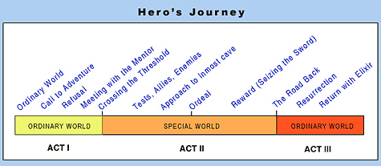
The hero’s journey in three acts

Slide 18
Storytelling
There is a central conflict between the demands of story and the demands of games
Stories tend to be linear
Though they can leap about temporally, they are experienced the same way every time
Games are non-linear
Though they are experienced over time, game sessions are normally different each time
When building a narrative into your game, you will necessarily have to have choices, in order to allow for meaningful play
Its generally better to have a structure that is deeper rather than broader

Slide 19
Deeper? Broader?

Slide 20
Academic writing style
If you make a statement
You must cite a source to support it
A statement without a source, is an opinion, which unless you can give a reason for (based on sound scientific practice, which you won’t have undertaken alongside this piece of work) has no place in academic writing
Compare and contrast
Consider different opinions from different sources. Don’t just pick the one you like and cite that – cite both and explain why you prefer one. Again, this explanation should have sound science behind it, otherwise do not include it.
This shows awareness
That you are not always correct
That the only way to be sure you are right is by performing sound science, or knowing the results when somebody else performed it
That there may not be black and white answers to everything, and even if you fall on one side of the debate, there may be valid arguments to be made for the other side

Slide 21
Academic language
Use formal language – no slang
If you are going to use acronyms, the first time you use them you must define them, once defined they may be used
i.e. “Artificial neural networks’ (ANNs)”
Do not over-use acronyms
Do not use abbreviations/contractions
“For example”, not “e.g.”
“Company” not “Co.”
“it is” not “it’s”
“Does not” not “doesn’t”
Avoid being subjective – i.e. “This fantastic concept”, “This is probably the best book ever written on the subject”, “Darwin was a very clever man”…

Slide 22
Academic language
Be precise – remember without evidence you cannot make statements, but you can make an observation
You cannot say “this is a critical element in creating a popular game” without a reference, but you could say “it would appear that this is a crucial element in creating a popular game, as it appears in most successful games”.
You cannot say “this is a major factor in this games success.” without a reference, but you could say “it is possible that this is a major factor in this games success, as it is the main differentiator from other similar games.”

Slide 23
Academic language
Do not write in the first person – ever.
NO
“I think that..” “I know that..”
“This was conducted by myself.” “I did this.” “It is clear to me that..”
YES
“It appears that” “It seems that”
“The author conducted this”, “It is clear that” *
* Don’t go crazy with “the author” – it’s a bit of a grey area, you’ll get away with it once or twice but too often means you’re writing very poorly

Slide 24
Finding references
So how do you find references?
Use the Library discovery service
This links you to materials from our library and from libraries across the world, which you can request (even if they are physical media) to be shipped to our library for you to read

Slide 25
ScienceDirect
Science Direct is a huge database of published academic literature
You can use this to find academic literature in a given area
If you login with your University ID you can get access to a lot of these papers (papers that the University has subscribed to the journal for)

Slide 26
Google Scholar
This is a great way to find academic work
Google allows you to filter and search through an even wider body of literature than science direct or discovery
The downside is you’re even more likely to discover papers you don’t have access too

Slide 27
Ordinary Google
If you know the paper title, or the authors name and year of publication, ordinary google search can be an effective way to find a paper
It is less useful when you are not looking for a specific paper

Slide 28
Researchgate
Research gate is a kind of researchers social network
Researchers can also share publications through this site, which means that it is one place publications may be available
And also that, if you know an author publishes in a specific field, you can have a look at what other work they’ve published if they’re on researchgate

Slide 29
What to do if you can’t access a paper?
Check if there’s a similar paper you can access, based on the title, authors and abstract
E-mail the authors and tell them you’re interested in their paper, and ask if they can send you a copy
Authors often have the rights to pre-release copies they are free to distribute, and gain no income from journal publications so won’t be losing out in any way by doing this

Slide 30
What counts as an academic reference?
In order of preference
Peer reviewed journal publications
Peer reviewed conference publications
Academic literatures, i.e. books, industry reports
PhD theses, Msc dissertations
Technical documentation produced by companies

Slide 31
What do not count as academic references?
Everything else!
But a short list of common problem references
Wikipedia (although sometimes a way to find proper references, Wikipedia is not peer reviewed and does not count)
Marketing websites published by companies (these are biased by their very nature)
Magazine articles (these have no scientific standing regardless of the author)
YouTube videos / tutorials

Slide 32
What if there is no literature?
You did not search hard enough.
There is enough literature out there that you can ALWAYS find something that is relevant
It doesn’t have to be 100% specific to your critique, it can be something from a different field even, as long as there is a link
For example, general design literature could be validly referenced in an analysis of a game design

Slide 33
Reading academic literature
Yes, I know you know how to read
Reading papers isn’t like reading a book, though
Read the abstract first, and identify if the paper sounds relevant enough to even bother continuing
Then, the introduction, which should allow you to identify key themes, aims, and what the paper will cover exactly
Skim the rest, and read the conclusions of the paper
If at this point, you think you should reference the paper, read through it another 2-3 times and try to gain an understanding of what the authors did, and how they reached their conclusions
Finally, if there is any math, try to understand this as a last step – you guys probably don’t need to worry about this too much
Handy hint – I find highlighters help me to separate out the key parts and important takeaways from papers

Slide 34
Tutorial
Get into groups of 2-3, and pick a game
Analyse the game, trying to identify the actions, what the outcomes from those actions are, and how they fit into the greater context of the game
Try to identify how this combination results in meaningful play within that game
Does the game have a narrative? If so, try to identify whether it fits with the hero’s journey structure, and whether it is branching or parallel?
Does this narrative contextualise outcomes of actions, helping to lead towards meaningful play? How?
Post your analysis in the forum on moodle once completed
Once complete – continue writing your assignments and seek feedback from tutors
Check your writing so far follows the hints and tips on academic writing and references that I’ve given today

